Slide 1



IBOR
Innovative solutions
for the outdoor space
Hans Rooden & Helmut Meert
September 29, 2022
On Tour

Slide 2
Agenda
01
02
03
04
05
What is IBOR ?
Use case
Street Lighting:
from Conventional
to
Smart
IBOR references
Questions & Answers
More information on IBOR

Slide 3
What is IBOR ?
IBOR -
Innovative solutions for the outdoor space

Slide 4

What is IBOR ?

Slide 5
What is IBOR ?
IBOR is an IoT platform enabling
    Remote configuration
    Control
    Command
    Monitoring
… on assets such as
    Street lights
    Traffic lights
    Road barriers
    Sewer systems

Slide 6
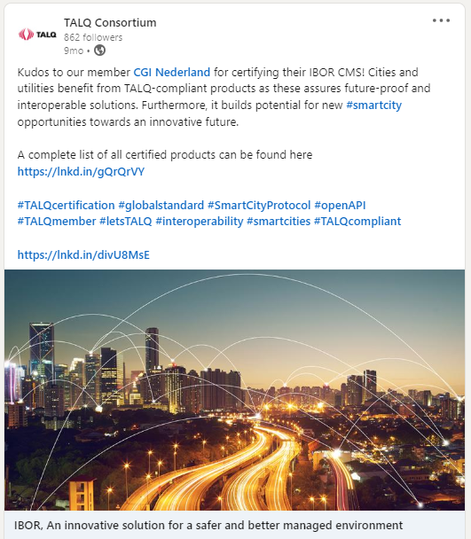



Why IBOR ?
Key differentiators of IBOR:
    Adaptable IP platform operational since 2014
    Secure and scalable
    On premise and/or Cloud platform
    Multitude service operation models incl. SaaS
    Vendor-independent
    A single platform with multiple adapters for
    device connectivity incl. BYOD
    Smart City certified TALQ CMS
    Open API for integration

Slide 7
Use case Street Lighting: from Conventional to Smart
IBOR -
Innovative solutions for the outdoor space

Slide 8
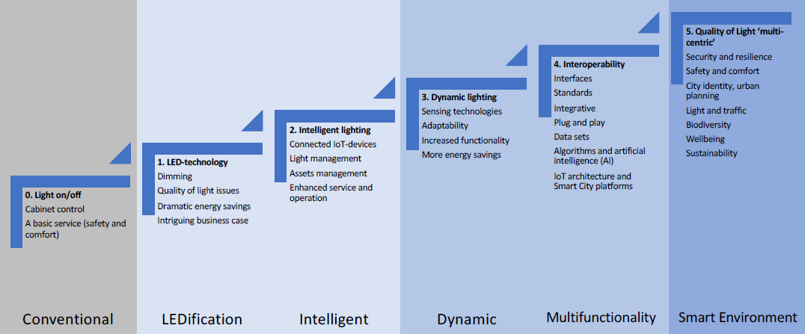
Use case Street Lighting: from Conventional to Smart

Slide 9


IBOR’s TALQ-based reference site (work in progress)
Per luminaire control based on location and asset management data
Manual override and/or scheduling in case of accidents, weather conditions and traffic jams, managed by operators
Open remote management API for integration with AI-platform
Dimming 0 – 100%
Easy-to-use installation & provisioning app
Cabinet monitoring
Centralized alarming & reporting
FLANDERS region, Belgium
Government agency: AGENTSCHAP WEGEN EN VERKEER
150,000 light points on highways and regional roads
controlled by a TALQ-compliant CMS
that is independent from device vendors
Implemented in 2023
2020: Start new SOW 2023: Working solution

Slide 10
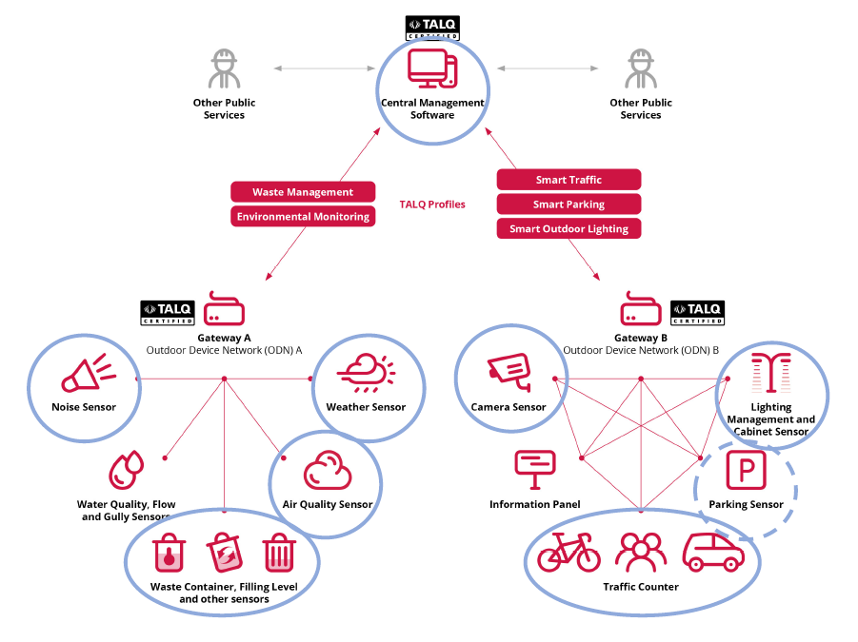
IBOR’s roadmap
TALQ reference site in Flanders region
is a first step, but this certainly not
the last …
Extension to the Smart City market
Extension to other use cases
Deeper implementation of TALQ
      Commissioning
      Firmware update
      Asset management
      …

Slide 11
IBOR references
IBOR -
Innovative solutions for the outdoor space

Slide 12

Rijkswaterstaat (RWS, the Netherlands) –
Ministry of Infrastructure and Water Management
The challenge
CGI’s solution
Key benefits
RWS is responsible for the road infrastructure and waterways in the Netherlands
RWS wants to switch off street lighting during the night
RWS needs an application to switch light on when required (emergencies, weather conditions, etc.)
CGI implemented IBOR for the control and management of lighting on the highways
Implementation on cabinet level to control luminaires per string
Accessible with operator terminals, tablets and smart phones
€ 91
yearly savings per luminaire
438 kg
reduction of CO2 emission
2 years
return on Investment
Ongoing

Slide 13

Agentschap Wegen en Verkeer (AWV, Belgium) –
Road and Traffic Agency of Flanders region, Belgium
The challenge
CGI’s solution
Key benefits
AWV is responsible for maintaining road infrastructure in the Flemish part of Belgium
AWV needs an application to manage road side cabinets and to switch lights on when required (emergencies, weather conditions, traffic jams, etc.)
CGI implemented IBOR for the control and the management of the road side cabinets
Implementation on cabinet level to control all assets (up to 64 inputs/outputs)
Private cloud infrastructure with high availability
Optimized infrastructure control and maintenance
Significant savings on street lighting
2015 Ongoing

Slide 14


Other reference cases
.
.
It is the City of Utrecht's ambition (the Netherlands) to implement a future city program integrating multiple objects in the public space
For the City of Utrecht CGI executed a pilot with IBOR on a major road
Traffic flow was managed with a connected traffic light system
IBOR’s benefit: Ready for smart city concepts
German national train operator Deutsche Bahn wants to reduce the carbon footprint by partly switching of the platform lighting during non operating hours
CGI executed a pilot with IBOR on a mid-size train station
Switching of the lights was based on train schedules (last train departure time) per platform
A custom fail-save mechanism was implemented to prevent full black-out of a platform

Slide 15



Other reference cases (cont’d)
.
.
.
For the city of Roosendaal (the Netherlands) CGI implemented IBOR for the management of public street lighting in a residential area
For the city of Leiden (the Netherlands) CGI implemented IBOR for the management of intelligent switches in the residential power grid
IBOR was successfully integrated with the ICT platform of the grid operator, the Open Smart Grid Platform
For the infrastructure department of the city of Düsseldorf (Germany) CGI implemented a POV for the management of a waste water clearing installation
It proves IBOR’s abilities to manage assets in waste water
The POV was operational within two weeks after the order

Slide 16

Questions & answers

Slide 17
More information on IBOR
Visit cgi.com/nl
Email us at helmut.meert@cgi.com
For IBOR’s factsheet, visit https://www.cgi.com/nl/nl/brochure/productie/ibor-innovative-solution-safer-and-better-managed and download the PDF file
For a video on Smart cities with CGI’s IBOR solution, visit https://www.cgi.com/en/media/video/smart-cities-cgi-ibor-solution

